Slide 1

Smart data analyser
turns raw data into valuable insights
Project Guide:
Ms.S.Divya bairavi ME.,(PH.D)
Assistant Professor
Department of AI & ML
Team members:
VISHWA S
-22619175
HEMNATH A -22619186
ZIYAD Z -22619196

Slide 2
ABSTRACT
The Smart Data Insight & Pattern Analyzer is a web-based application designed to simplify and automate the process of data analysis. In today’s data-driven environment, extracting meaningful insights from raw datasets is essential yet often complex and time-consuming. This system addresses the challenge by enabling users to upload structured data (CSV files) and instantly generate statistical summaries, visualizations, and interpretable insightsThe application integrates modern web technologies with data processing techniques to perform tasks such as data preprocessing, statistical computation, correlation analysis, and pattern detection. It presents results through intuitive charts and human-readable explanations, allowing users to easily understand trends, relationships, and anomalies within the dataset.

Slide 3
INTRODUCTION
In today’s digital world, large amounts of data are generated every day, but extracting meaningful insights from this data remains a challenge. Manual analysis is time-consuming and often requires technical expertise.
To address this, we developed the Smart Data Insight & Pattern Analyzer, a web-based application that automates data analysis. It allows users to upload datasets and instantly generates statistical summaries, visualizations, and meaningful insights.
This system simplifies complex data analysis processes, making them accessible to both technical and non-technical users, and supports better data-driven decision-making.

Slide 4
PROBLEM STATEMENT
In today’s data-driven environment, large volumes of data are generated continuously, but extracting meaningful insights from this data remains a complex task. Existing data analysis tools often require technical expertise, manual effort, and significant time to preprocess, analyze, and interpret data.
Additionally, most tools provide only raw statistics and visualizations without meaningful explanations, making it difficult for non-technical users to understand the results. Data quality issues such as missing values and inconsistencies further complicate the analysis process.
Therefore, there is a need for an intelligent and user-friendly system that can automatically analyze datasets, identify patterns, and generate clear, actionable insights with minimal user effort.

Slide 5
PROPOSED METHODOLOY
The proposed system follows an automated and structured approach to data analysis:
Data Input: Users upload structured datasets in CSV format through the web interface.
Data Preprocessing: The system identifies data types, handles missing values, and prepares clean data for analysis.
Statistical Analysis: Key statistical measures such as mean, median, and standard deviation are computed.
Pattern Detection: Relationships between variables are identified using correlation analysis and grouping techniques.
Data Visualization: Graphs such as bar charts, histograms, and heatmaps are generated for better understanding.
Insight Generation: The system produces human-readable insights highlighting trends, patterns, and anomalies.
Result Presentation: All outputs are displayed through an interactive and user-friendly interface

Slide 6
SYSTEM MODULES & TECHNOLOGY
Data Upload Module
Allows users to upload CSV datasets into the system.
Data Preprocessing Module
Cleans the data by handling missing values and identifying data types.
Statistical Analysis Module
Computes key metrics such as mean, median, and standard deviation.
Pattern Detection Module
Identifies relationships and trends using correlation and grouping.
Visualization Module
Generates charts like bar graphs, histograms, and heatmaps.
Insight Generation Module
Converts analytical results into human-readable insights.
User Interface Module
Provides an interactive and easy-to-use web interface.

Slide 7
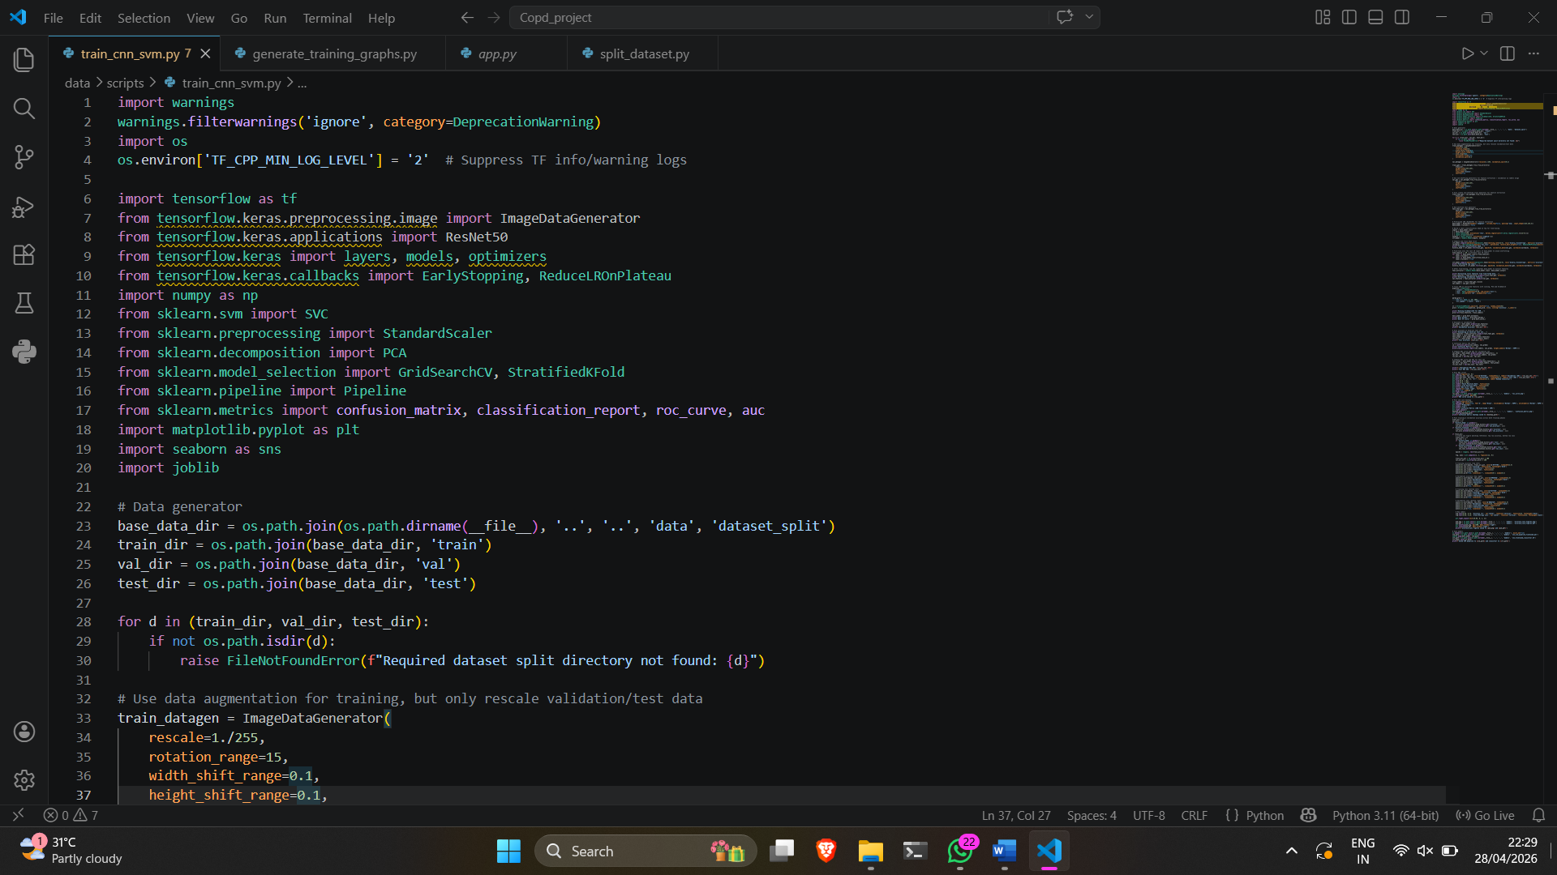
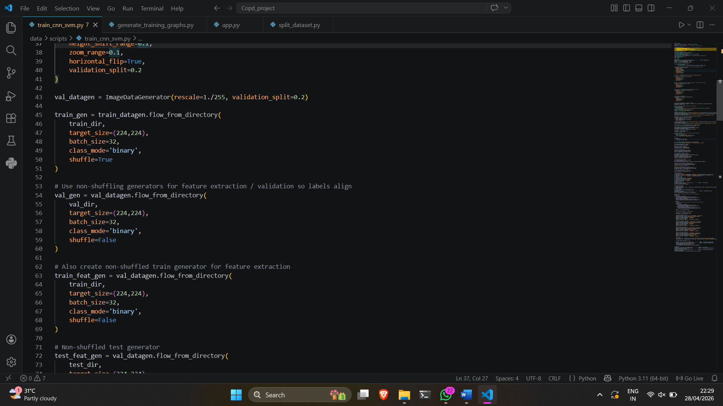
Sample Code:

Slide 8
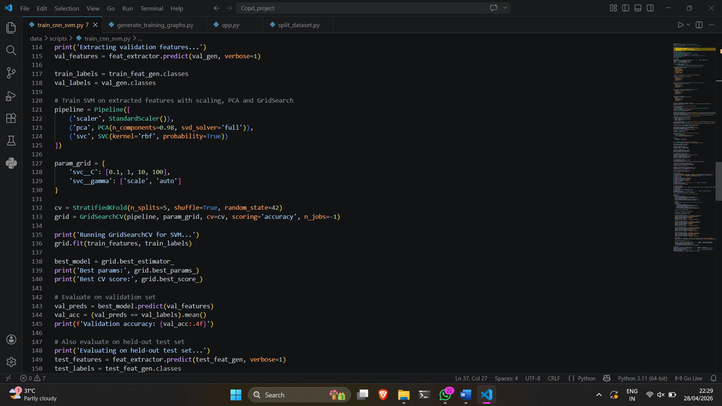
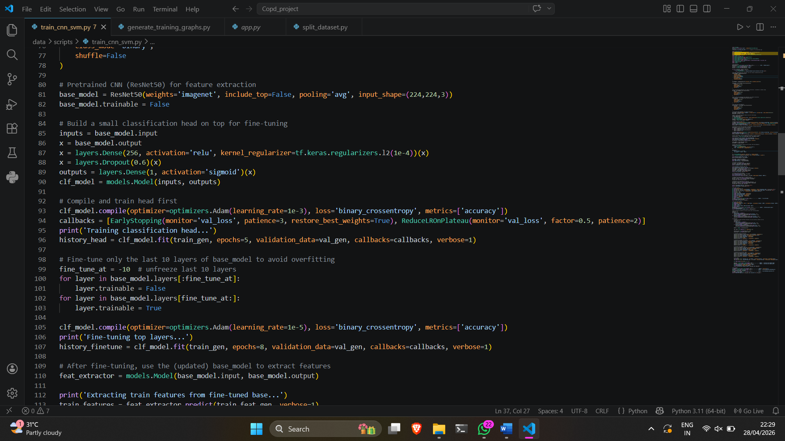
Sample Code:

Slide 9
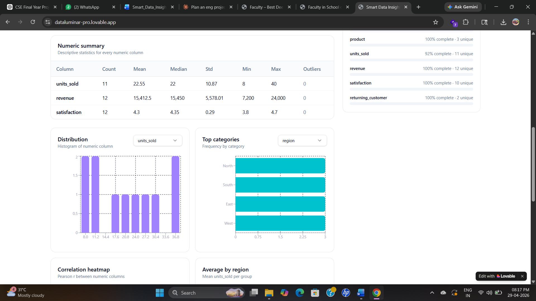
OUTPUT SCREENS

Slide 10
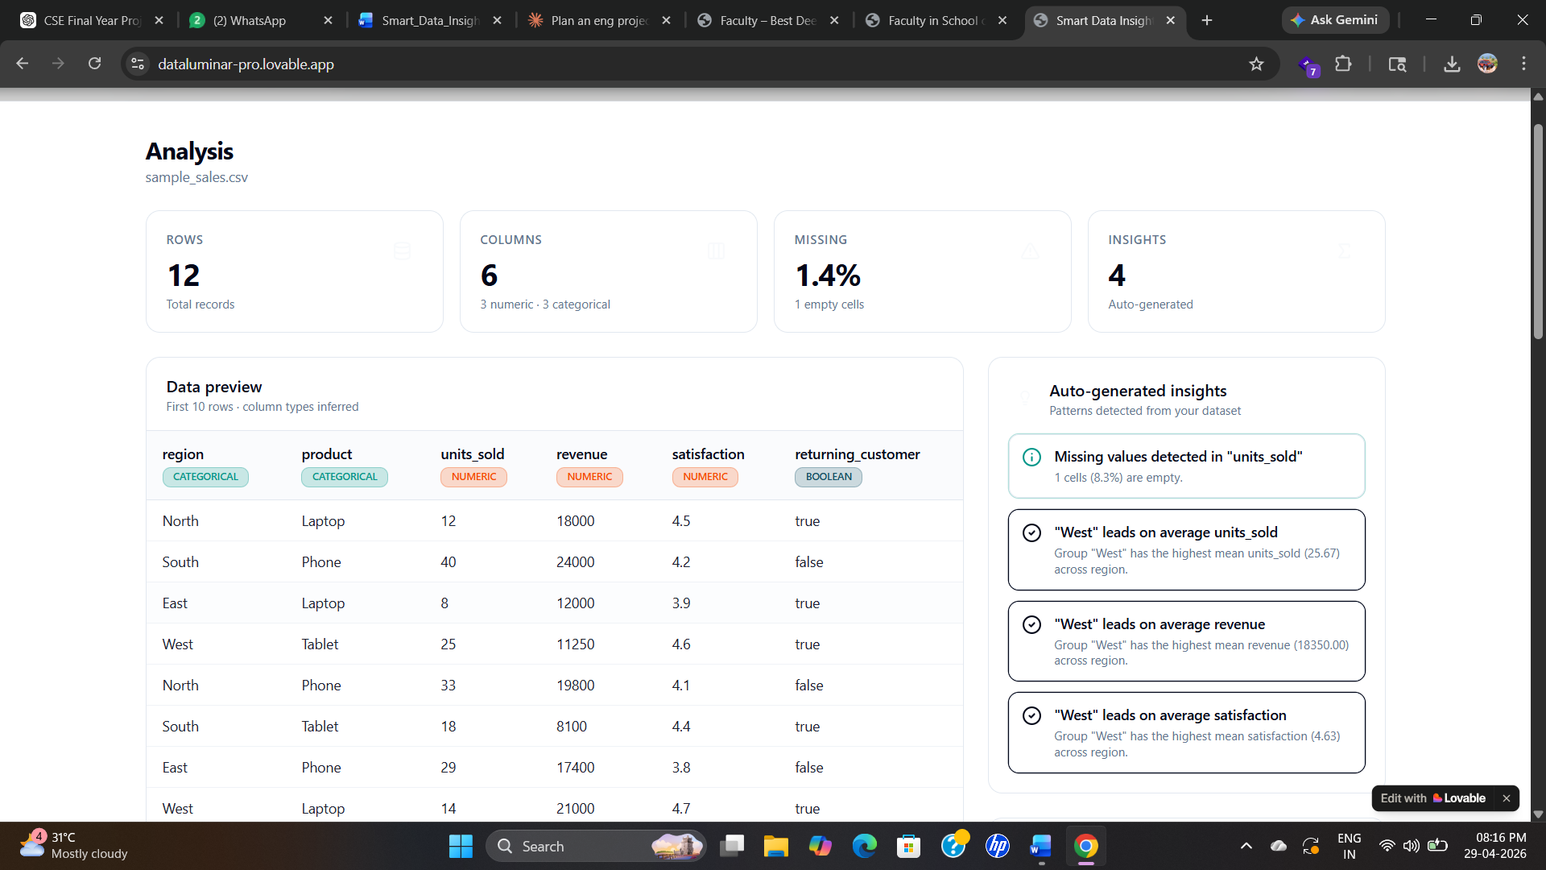

Slide 11
CONCLUSION
The Smart Data Insight & Pattern Analyzer successfully demonstrates an efficient approach to automated data analysis. The system simplifies complex analytical processes by enabling users to upload datasets and instantly obtain statistical summaries, visualizations, and meaningful insights.

